Slide 2
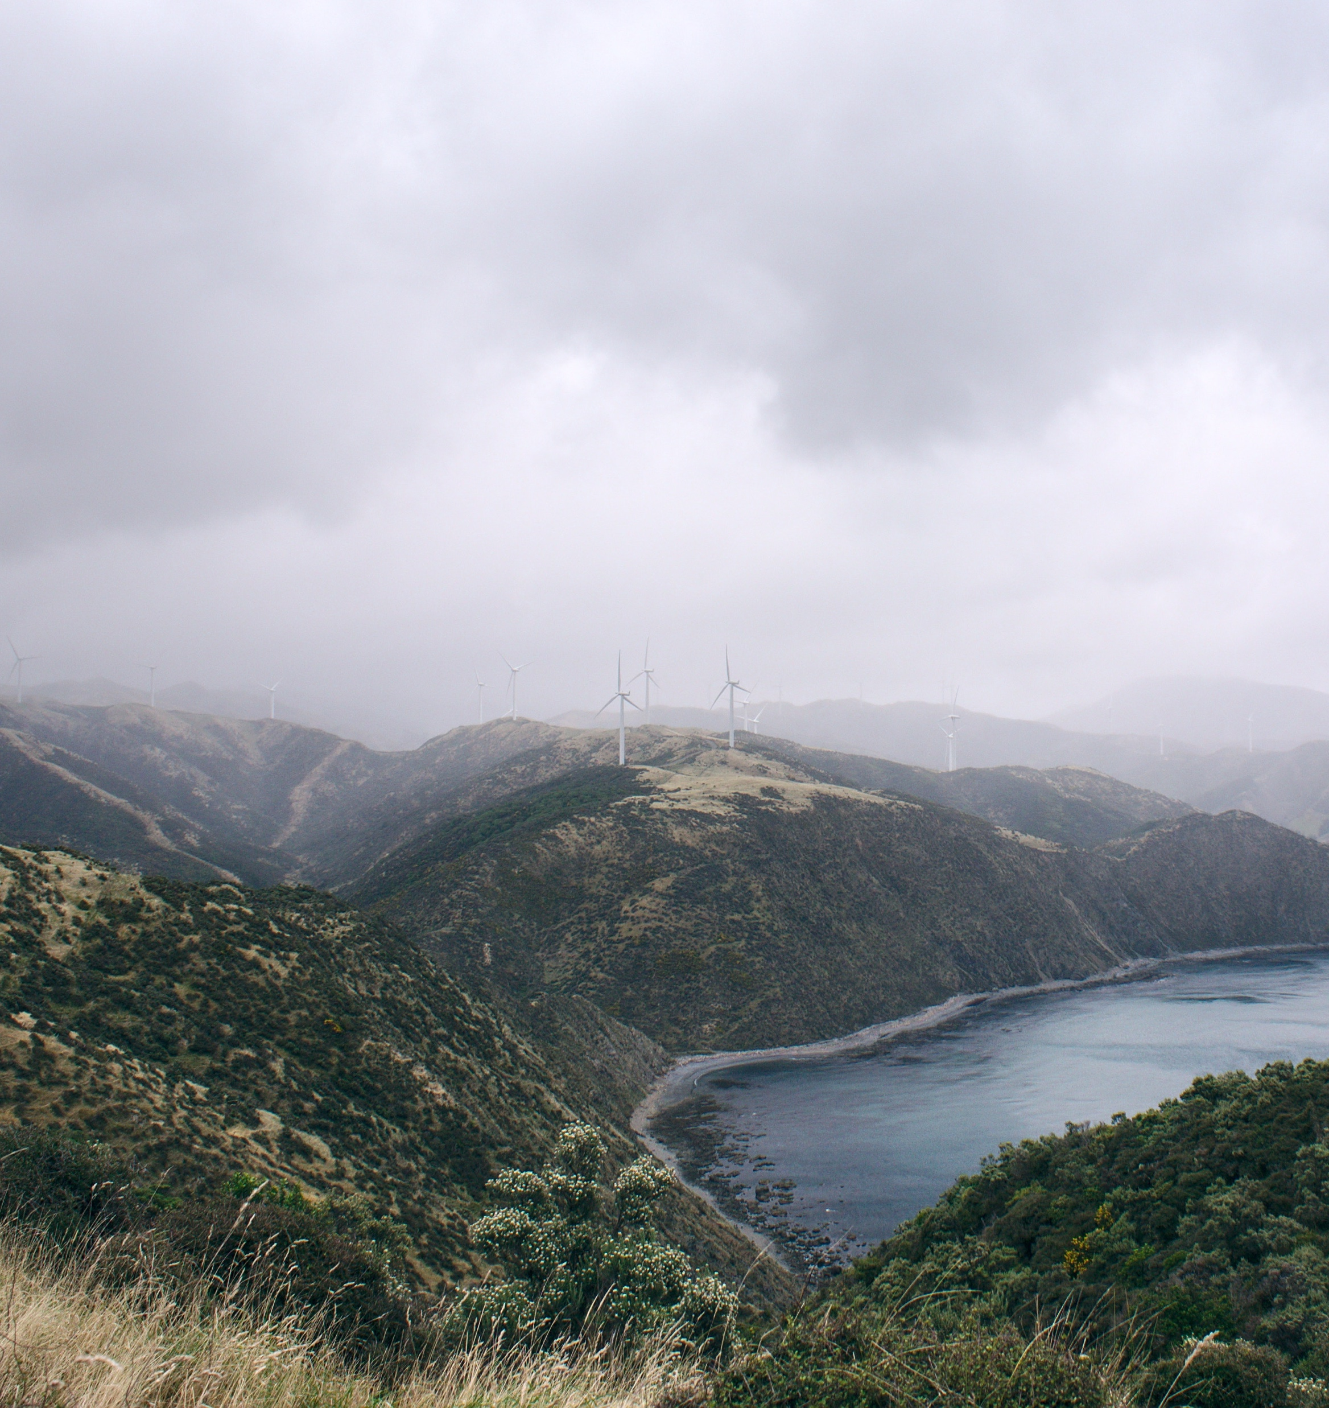
Draft CCC advice
Covers
Emission budgets 2022-25, 2025-30, 2031-35
Policy direction and forecast emissions
Review of current NDC (30% below 2005 levels by 2030)
Submissions due 28 March 2021.

Slide 3
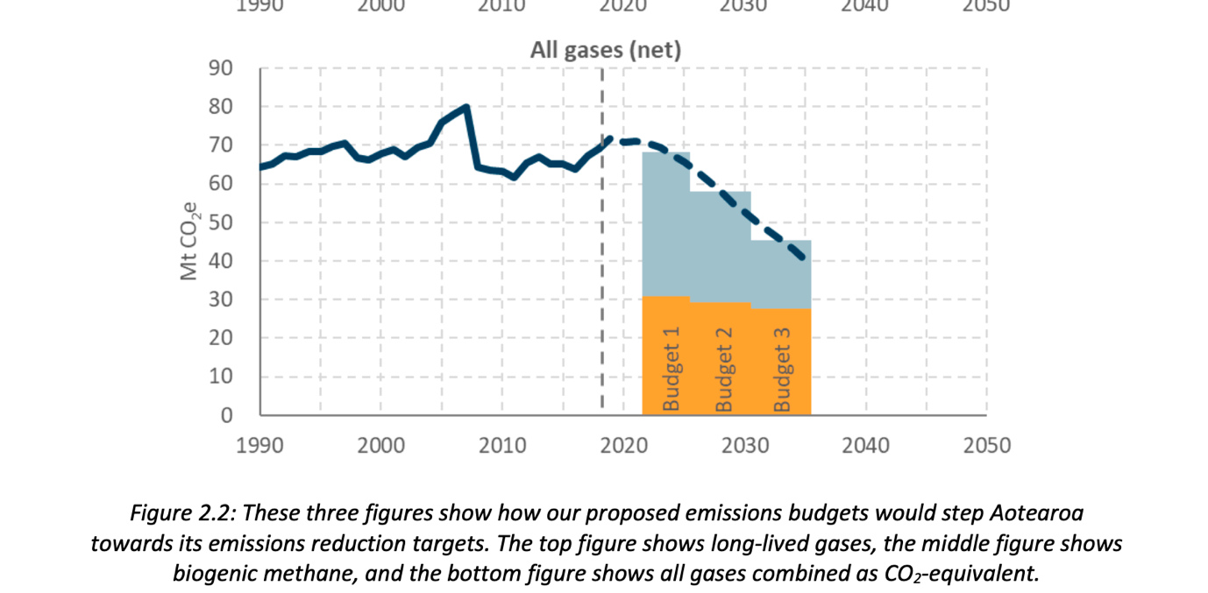
1. General comments
We have focussed on 2021-30
2021-30 ZCA budget = 628 mTCO2 equiv
At 2030, forecast emissions = 52 mT (20% less than 2010)

Slide 4
1. General comments (continued)
Meaningful reductions by 2030 (contrast last two decades)
Moves the policy discussion to “how”
Emphasises importance of bipartisan support
Prioritises reducing gross emissions over removals through forestry (and places emphasis on native forests)
But is it ambitious enough?

Slide 5
2. Statutory purpose
Commission must act in accordance with the Act’s purpose – s 3(2)
Act’s purposes (s 3) include:
contributing to the global effort to limit the global average temperature increase to 1.5° Celsius; and
enabling New Zealand to meet its international obligations, including under the Paris Agreement.
Other considerations which the Commission must take into account do not outweigh the requirement to comply with the Act’s purpose
Advice which is not consistent with these purposes would be unlawful and at risk of judicial review
Courts in other jurisdictions have rejected inadequate emissions targets and policies and required States to adopt tougher measures

Slide 6
3. 2021-30 emissions and 1.5°
Globally, limiting warming to 1.5°C requires a reduction from nearly 60Gt pa (2019) to 25Gt pa in 2030 (source UNEP: Emissions Gap Report 2020)
Against this our budgeted reductions look modest
Raises a number of issues:
How is a 20% reduction relative to 2010 emissions defensible?
CCC found that that our net emissions for 2021-30 should be no more than 564Mt to limit warming to 1.5 (NDC analysis). So, why did the CCC set the 2021-30 budgets at 628Mt?
564 based on global averages. CCC found that New Zealand’s fair share required “much more” ambition. What # does this imply?
Is “564” the right starting number?

Slide 7
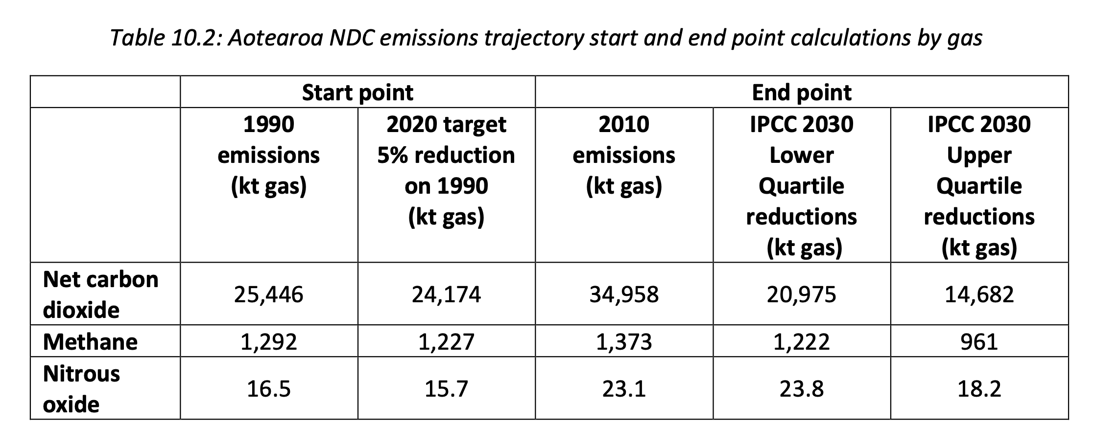
4. “564” contains a math error
Using a split-gas approach, CCC calculates 2030 net CO2 target as 2010 level with a reduction of -40 to -58% (interquartile range)
This feeds into the 2030 target of 52 mT (all gases) and the 564 mT budget
However, the number the CCC uses for 2010 net CO2 is 34.958 mT which was our gross CO2 emissions (Table 10.2, sup chap 10)

Slide 8
Our net CO2 emissions (taking into account forestry) in 2010 were:
21mT Kyoto net (35mT minus 14mT)
7mT GHG Inventory net (35mT minus 28mT)
If we make this correction, then the 2030 all gases target would drop from 52mT to:
45mT Kyoto net (and 564mT would become approx. 530 mT)
38mT GHG Inventory net (and 564mT would become approx. 500 mT)

Slide 9
Why does the CCC apply the IPCC % reductions for net CO2 to our gross CO2 emissions?
Spillover from gross:net accounting?
Our NDC is expressed as “New Zealand commits to reduce greenhouse gas emissions to 30% below 2005 levels by 2030”
However, officials interpret it as follows: “New Zealand commits to reduce our net greenhouse gas emissions to 30% below 2005 levels of gross greenhouse gas emissions by 2030”

Slide 10
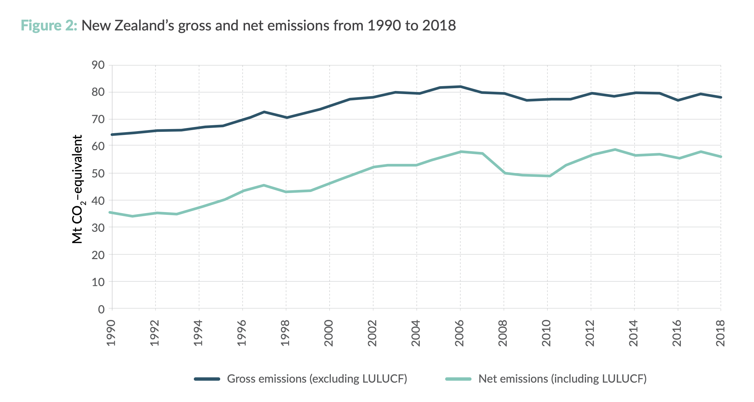
Since our gross emissions
are higher than our net
emissions, we think the
headline figure in our
NDC overstates our true
level of ambition
Officials think that CO2 removals due to forestry in base years should be disregarded when setting future targets because new plantation forests deliver one-off removal over first decades only
But even we express our targets as gross:net, using the 2010 gross CO2 figure doesn’t make sense in these calculations

Slide 11
5. Doing our fair share: What does “564” become?
“564” is based on global averages.
Our “fair share” involves responsibility for past emissions; per capita sharing of the remaining global budget and capability to reduce
The CCC concludes we should make “significantly deeper” reductions than the global average, but doesn’t put forward a number
Oxfam’s (2020) analysis is that our fair share would involve an 80% reduction from 1990 emission levels.
In contrast, “564” equates to a 35% reduction from 2005 levels (gross:net).
If we took “fair share” and “highest possible ambition” seriously, what number would we end up with? CCC doesn’t express an opinion.

Slide 12
6. Methane: An extra reason to do more faster?
New Zealand’s unique emissions profile: half from methane
In calculating “564” the CCC looks at methane and CO2 separately
IPCC predicts slower reductions in methane (-11 to -30%) than in CO2 (-40 to -58%) between 2010 and 2030
Because of methane’s high share in NZ, our % target reductions are lower than global averages when expressed in terms of all gases
We’re not against the split-gas approach per se, but:
CCC treats this range as a normative target when it was just an estimate of a global average
Using GWP₁₀₀ gives methane a 25x multiplier for CO2 equivalent purposes, but this underweights its impact in terms of temperatures over the next 3 decades

Slide 13
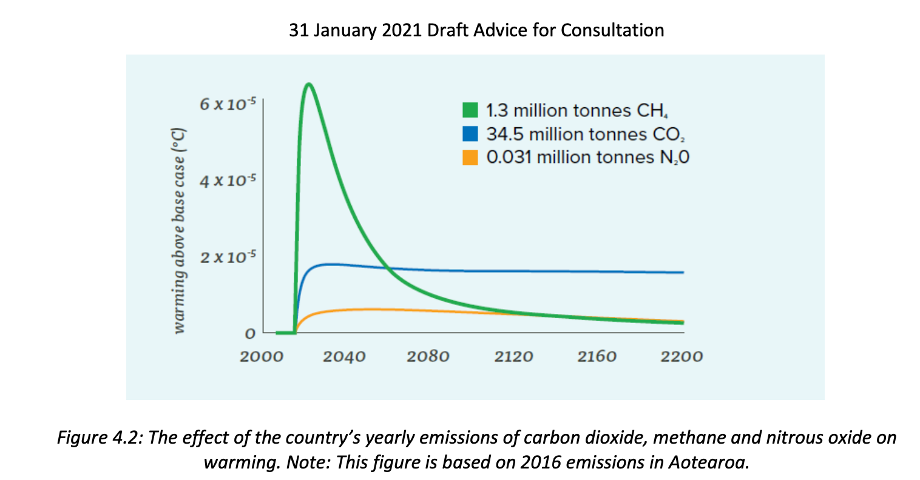
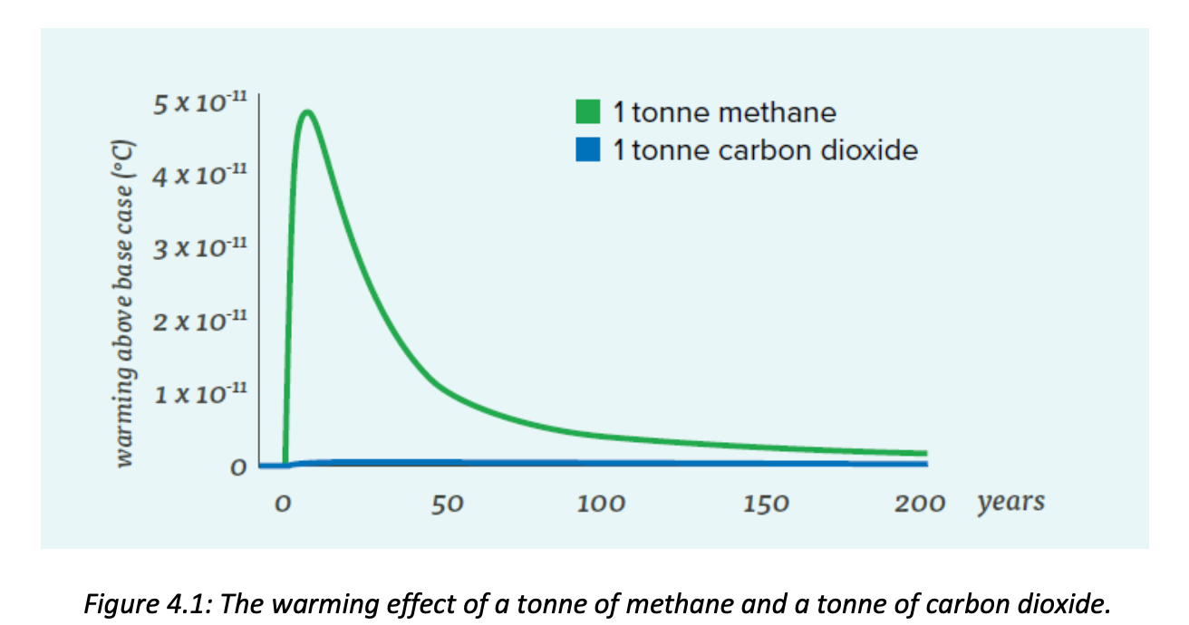
Methane: Greater short-term warming but faster breakdown
Important for peak temperatures this Century

Slide 14
7. What should our ZCA budgets be?
The science + our fair share require 2021-30 emissions to be well below “564”. Potentially much much lower.
Returning to the statutory purpose, we think this should cap our ZCA budgets (cf 628)
CCC approach to the budgets seems to be to look at how much emissions can reduce without too much disruption
CCC does not analyse options available to reduce 2021-30 emissions to this level of ambition or what the cost would be

Slide 15
8. Policy direction
Concern about achievability: no analysis of regulatory changes needed to implement policy proposals and time-path for those, reliant on cooperation and coordination of many players
ETS
CCC has foccussed on multiple specific policy interventions
Role of ETS is unclear and its major failings are not addressed (eg linkage to agriculture emissions, addressing the stockpile)
Importance of monitoring mechanisms in case policy intiatives do not deliver

Slide 16
9. Buying overseas credits
The CCC’s view is that the gap between ZCA budgets 2021-30 (628) and a 1.5 degrees compliant 2030 NDC (564) can be bridged by purchasing overseas credits (Advice p 155).
The reasoning being that although the ZCA requires budgets to be met as far as possible out of domestic mitigation (s 5z) offshore mitigation can be used to meet NDCs.
However, a mechanism for Article 6 of the Paris Agreement which could potentially provide access to offshore markets has yet to be agreed- there are only a small number of countries who have indicated in their NDCs that they wish to use it- and indications are that under any agreed structure there may be restrictive criteria similar to s 5Z.

